Slide 1
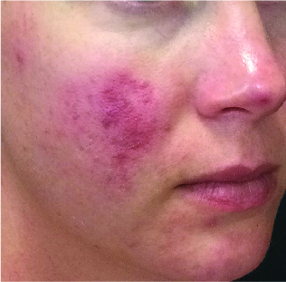
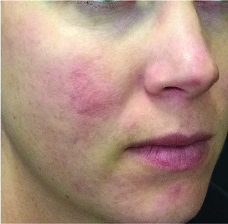
BEFORE / AFTER | 5 months post 7 tx | courtesy of Carrie Labert, PA-C
ForeverClear™
Step1: 420 nm Filter, 5 J/cm², 260 ms, 15˚C Cooling, 3 Passes
Step 2: 560 nm Filter, 9-12 J/cm², 15-20 ms, 15˚C Cooling, 2 Passes
560 nm Filter, 15 J/cm², 18 ms, 15 ˚C Cooling, 2-3 Passes (Cheeks, Nose, Chin)
Step 3: SkinTye: 590 Filter, 12 W/cm², 12 sec, 30 ˚C Cooling
1
©2019 Sciton, Inc. All rights reserved. 2600-034-33 Rev. A B&A FCBBL

